Slide 1

Immersive Technology Development
Lesson 1:
Augmented Reality
Elyas Chua-Aziz
cel9@np.edu.sg
Diploma in IM
October 2021

Slide 2
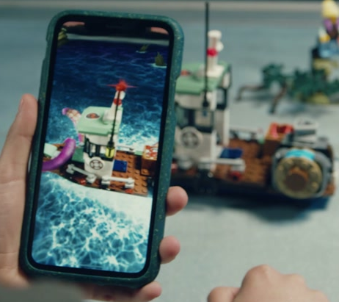
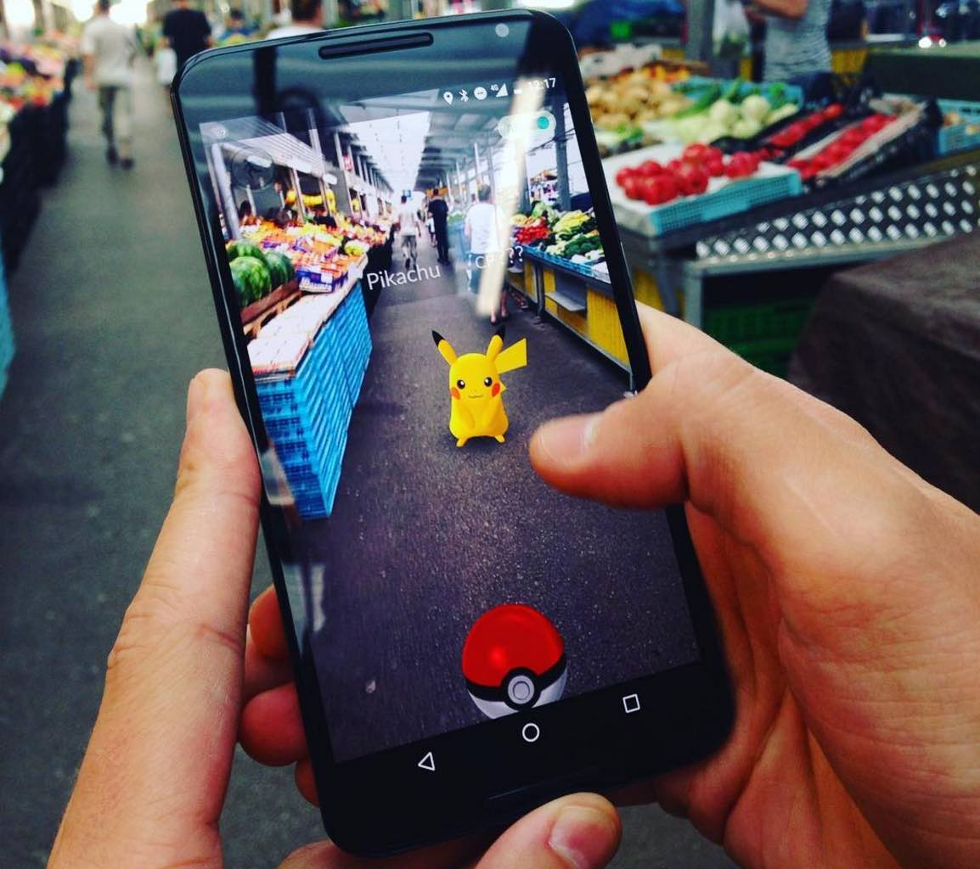
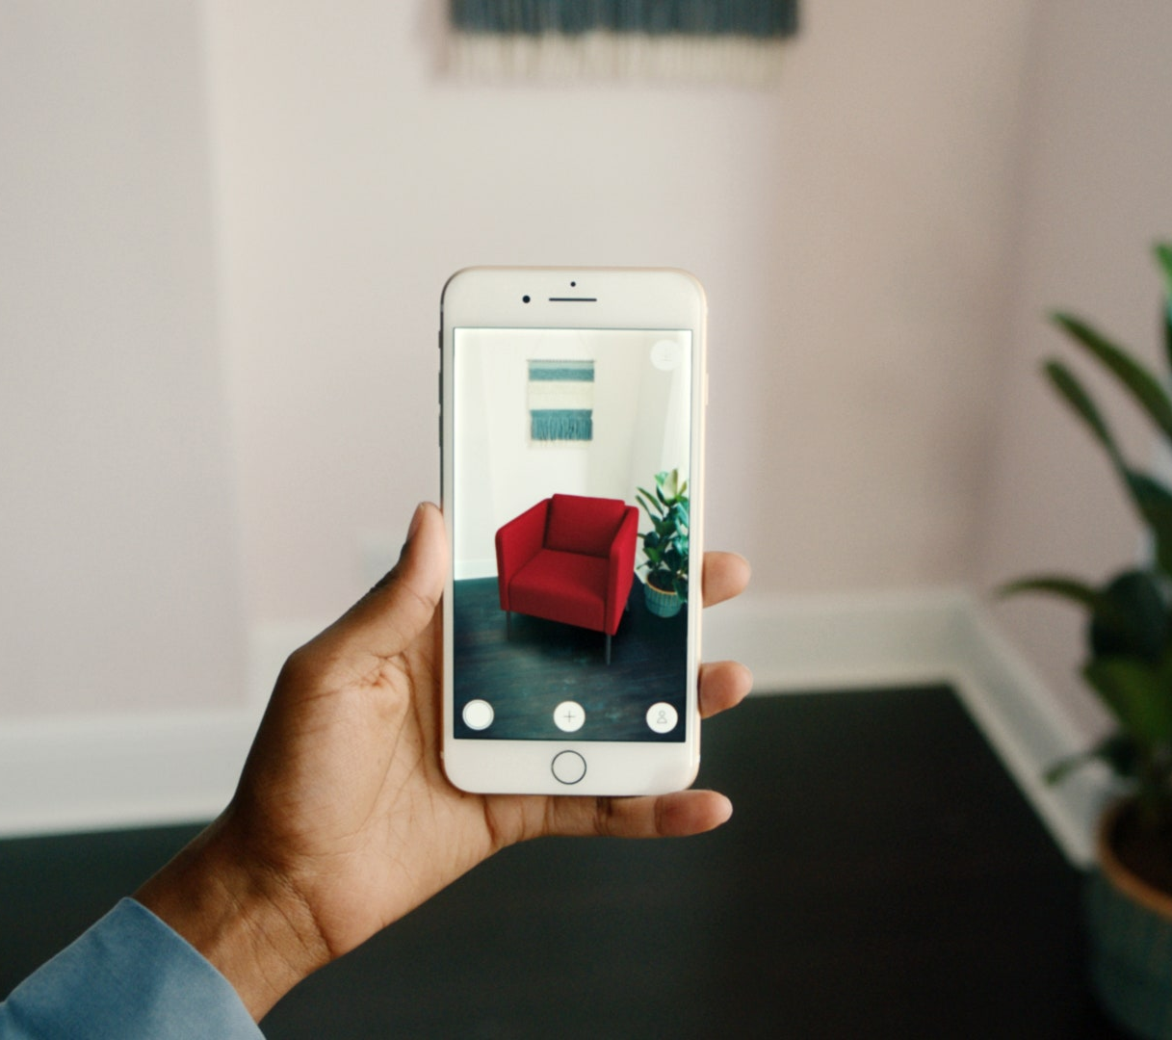
Augmented Reality
Augmented Reality (AR) refers to using technology to overlay digital information and data onto real world objects.
To achieve this, users have to see the real world ‘LIVE’ and as it is at the moment.
AR allows us to manipulate the space that our users see and alters their perception of reality.

Slide 3
Lesson Objectives
Set up Unity to work with Vuforia.
Use Vuforia to create image tracking functionality.
Create an AR project that can be tested on your laptop/AR device.

Slide 4
Augmented Reality
To develop AR applications with Unity, we will use Vuforia to help us.
By incorporating the powerful tools of Vuforia into Unity, AR development is made quicker, and handles the trouble of tracking objects in real time.

Slide 5
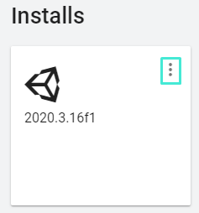
Setting up Unity
First, open Unity Hub and select the ‘Installs’ tab.
Find the version that you are using, and click on the meatballs icon.

Slide 6
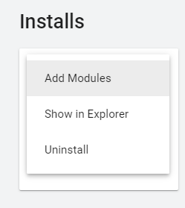
Setting up Unity
Select the ‘Add Modules’ option.

Slide 7
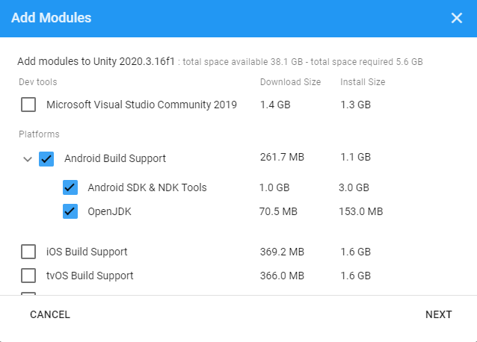
Setting up Unity
In the ‘Add Modules’ window, check ‘Android Build Support’. Make sure both the SDK and JDK options are checked as well.
Click ‘NEXT’.
Agree to the T&C and allow Unity to handle the installation.

Slide 8
Setting up Unity
Why Android?
Easier to develop for and publish on Google Play Store
iOS requires all developers to use Macs
When deploying to the App Store on iOS, developers MUST enroll in the Apple Developer Program (99USD/year), and apps must be submitted to Apple for approval.

Slide 9
What Devices Can I Use?
Laptop | Phone | Can Use?
Windows | Android
Windows | iPhone
Mac | Android
Mac | iPhone

Slide 10
Setting up Vuforia
Before we can use Vuforia, we have to register for an account on Vuforia.
Head to the Vuforia website:
https://developer.vuforia.com/
Register for an account using your school email.

Slide 11
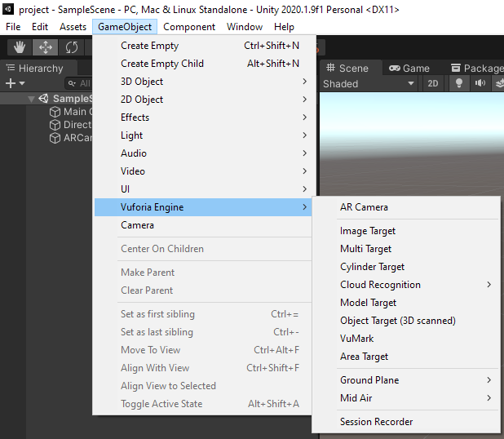
Setting up Vuforia
Create a new Unity project.
Then download the Vuforia Core Samples from the Unity asset store here:
https://assetstore.unity.com/packages/templates/packs/vuforia-core-samples-99026
If the package was imported successfully, you will see a ‘Vuforia Engine’ option when you try to add GameObjects into your scene.

Slide 12
Demo Time!

Slide 13
Working with Vuforia
First we must create the most important thing for an AR application, an AR camera.
Go to GameObject > Vuforia Engine > AR Camera to create one.
Our application is now ready to detect and track objects.
Before we can create objects to track, we have to add a license key.
Head back to the Vuforia website.
Click on the Develop button on the header.

Slide 14
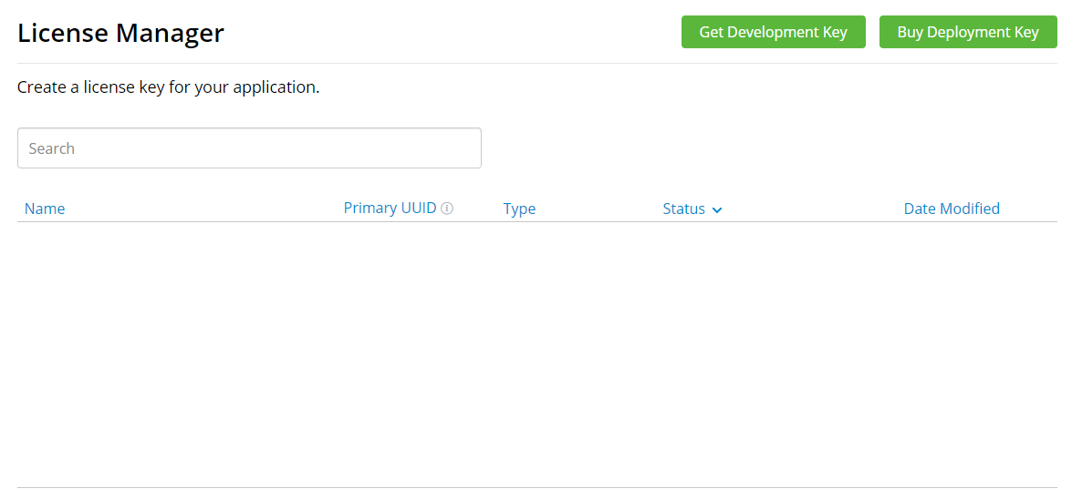
Working with Vuforia
Click on Get Development Key
Any Licenses you have will appear in this area

Slide 15
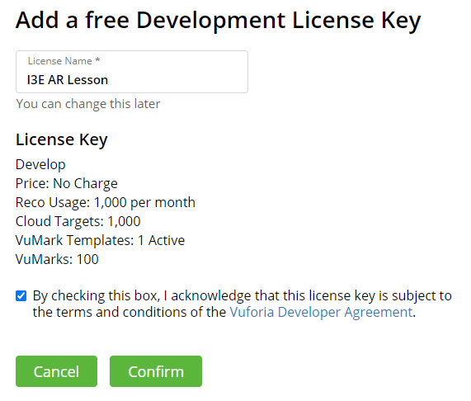
Working with Vuforia
Give your License Key a name so that you can easily identify it.
Check the box at the bottom, then press the Confirm button to create your License Key.

Slide 16
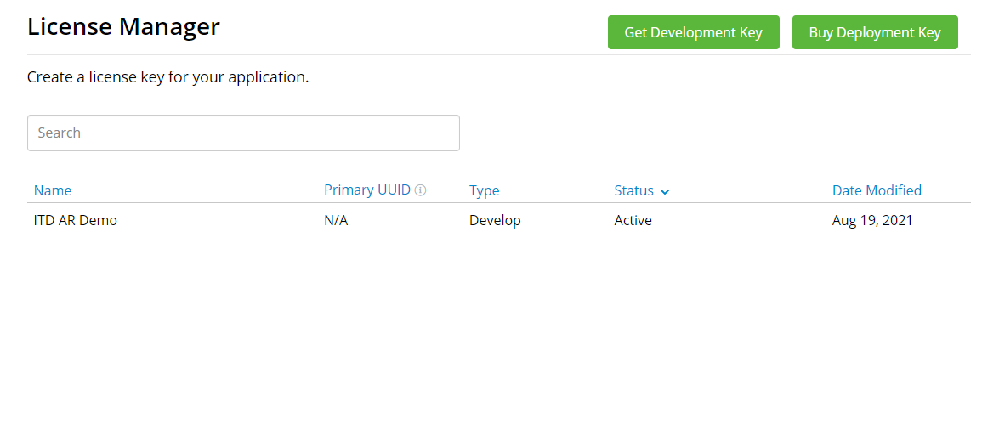
Working with Vuforia
Your new License Key will appear here.
Click on the entry and copy your license key in the next page.
We will need to paste this key into Unity for Vuforia to work properly.

Slide 17
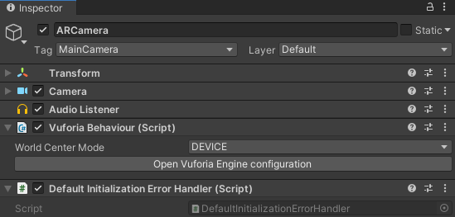
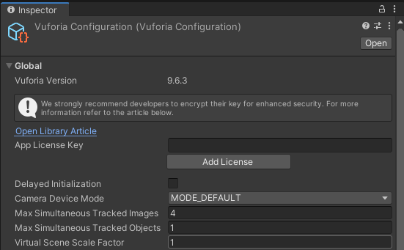
Working with Vuforia
Back in Unity, select your ARCamera in the Hierarchy.
Click Open Vuforia Engine configuration in the Inspector.
Paste the license key you copied into the App License Key text field.
Now we will be ready to properly create our AR application.

Slide 18
Demo Time!

Slide 19
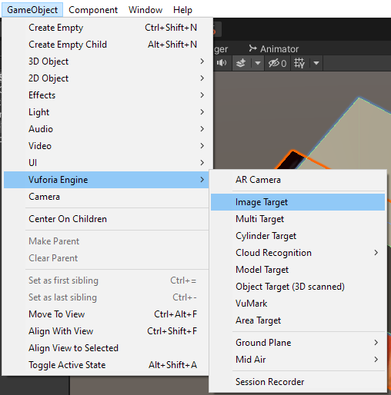
Working with Vuforia
There are many different tracking objects we can create, but we will start with the most basic, an Image Target.
To create an Image Target, go to GameObject > Vuforia Engine > Image Target
A blank Image Target should appear on your scene
Do not worry if it seems to be too small. AR works with real world measurements, so everything will seem a little smaller than what we are used to.

Slide 20
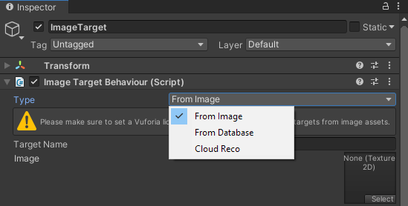
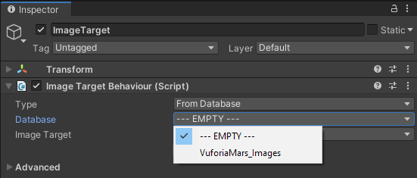
Working with Vuforia
Select your Image Target, then change its Type to From Database in the Inspector.
This will expose some new fields you can set.
Change the Database from EMPTY to VuforiaMars_Images.

Slide 21
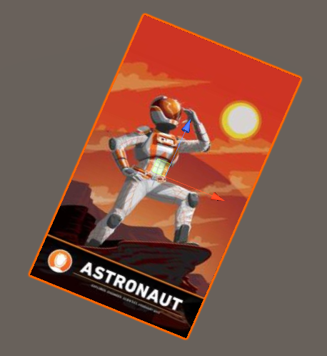
Working with Vuforia
The once blank Image Target will now display this Astronaut image.
With our Image Target set up, we can now define what our application should overlay once it detects this image in real life.
To do this, we create a 3D object and make it a child of our Image Target.

Slide 22
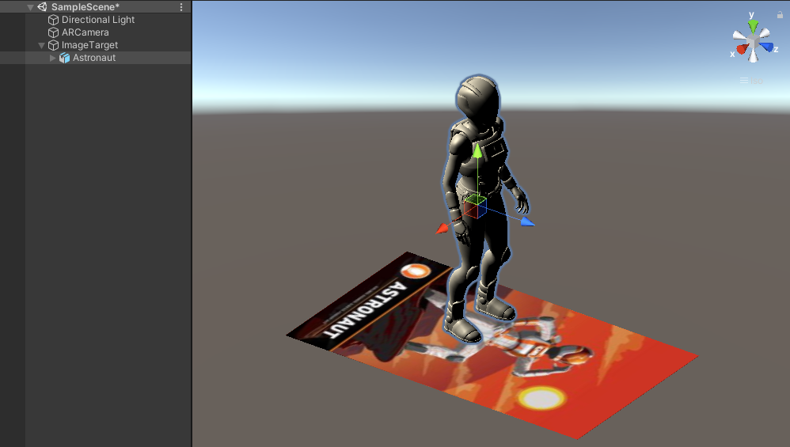
Working with Vuforia
You can find this in the Vuforia assets that were imported
This Astronaut object will be rendered when our Image Target is detected.

Slide 23
Demo Time!

Slide 24
Your turn!
Import the Vufo

Slide 25
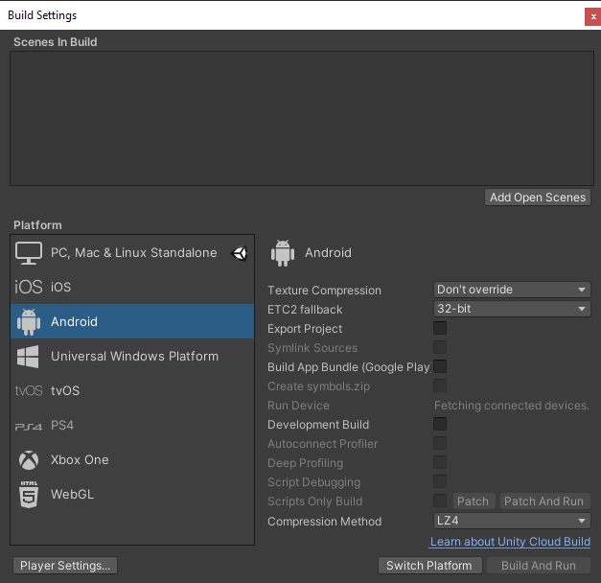
Testing Vuforia
Now that we have a basic scene set up, we can test our application.
To do this, we first have to set our Target Platform to Android in our Build Settings.
Select the ‘Android’ option, then click on the Switch Platform button to change the Target Platform.
Unity will take some time to switch platforms.

Slide 26
Testing Vuforia
With the proper Build Settings, we can now either test our application using a webcam or an Android mobile device.
To use a webcam, make sure you have one connected to your computer.
Unity and Vuforia may ask for permissions to be granted. Be sure to grant them, or your application will not run.
Press the Play button and the application should display the view of your webcam in the Game window.
While it does not give us the proper experience, testing directly from your development machine is often faster at the start.

Slide 27
Testing Vuforia for Android
In order to get the proper mobile experience, we will have to test on a mobile device.
To test on an Android device, we must set up the device properly.
First, enable Developer Options on the device.
This is typically done by going to Settings > About Phone > Software Information > Tap ‘Build Number’ 7 times.
A new ‘Developer Options’ will be available at the bottom of your phone settings.
Next, enter Developer Options and enable ‘USB Debugging’.
Your Android device will now be ready to test your Unity AR Application.

Slide 28
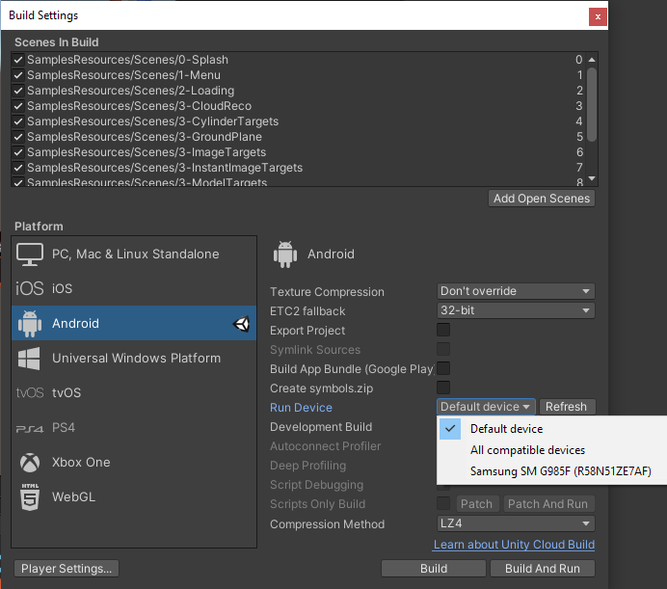
Testing Vuforia for Android
Connect the Android device to your development machine.
Go to Build Settings again, and look for your device in the Run device section.
If your device is not found, make sure your connection is not compromised then click Refresh.
The string of text should match the serial number of your device.
Select your device, then click Build and Run.

Slide 29
Demo Time!

Slide 30
Your turn!
Create an AR project in Unity with an Image Target in the scene.
Have any 3D object as the child of the Image Target so that it will spawn once the target is detected.
Test the application and take a screenshot (either on your laptop or phone) of the 3D object being spawned.
Upload the photo here: https://docs.google.com/presentation/d/1nxLeUrjmNINSSZo4md1Y5RwHRINt1ua_CR8m0FxmbJw/edit?usp=sharing

Slide 31
Summary
Vuforia gives us the necessary tools to create an AR experience in Unity.
In order to use those tools, we must sign up on the Vuforia website and get a license key.
Once the license key is entered in Unity, we can start using the Image Tracking capabilities of Vuforia to start building our AR experience.
The Unity project can be tested with the laptop camera (faster testing), or on an AR device (e.g. mobile phone; slower because of build time but more accurate feel).

